Slide 1
Big Mountain Resort
Pricing Model
Michaella Phillips 1/6/2021

Slide 2
Agenda

Slide 3
Problem Identification
How can Big Mountain Resort increase revenue?
Change pricing strategy to develop a more fair ticket price
Currently using a premium above the average market price
Concerned that Big Mountain is not capitalizing on their facilities
Are there other ways to cut costs?
Remove facilities that don’t add enough value
Add facilities that give reason to increase ticket price

Slide 4
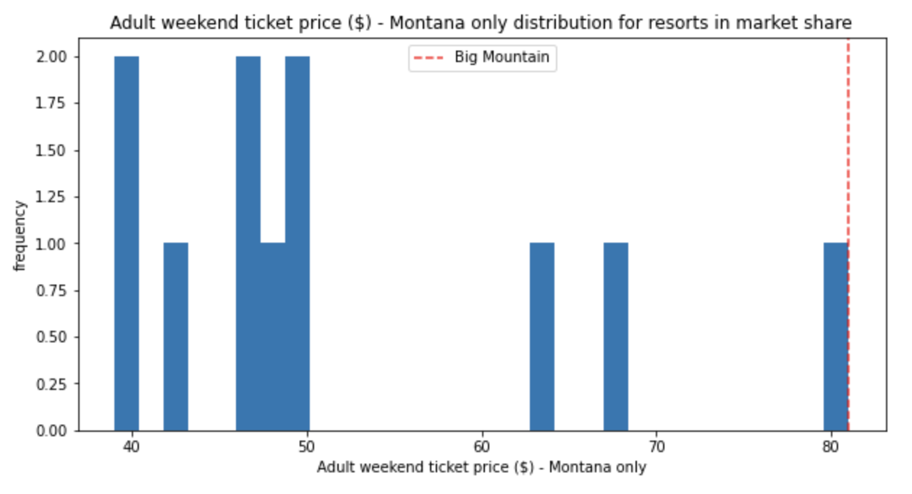
Recommendations and Key Findings
Increase Ticket Price?
Big Mountain is already the highest priced resort in Montana.
Facilities:
In the top for snow making, chairs, runs, vertical drop, and fast quads
Model
Predicted increase to $95.85 based on current facility
Closing unused runs would increase profit.
Overall
Price of tickets should increase based on not capitalizing on the facilities
Closing less popular runs could help increase revenue by lowering ticket price and operation costs.

Slide 5
Modeling Results and Analysis
Random Forest Model was used to predict Big Mountain’s Pricing
The Model predicted Big Mountain to price its tickets at $95.87
Price with this model is expected to be within $10.39
Big Assumption: other resorts are not over or under pricing as well
Key Features that greatly affected the model:
Number of fast 4 person chairs
Most resorts have none, but Big Mountain has 3
Number of runs
Big Mountain has one of the highest numbers of runs at over 100 runs
Total area with snow making
Big Mountain has one of the highest areas covered by snow (~600 acres)
Vertical elevation from summit to base.
One of the highest vertical elevation at over 2000ft.

Slide 6
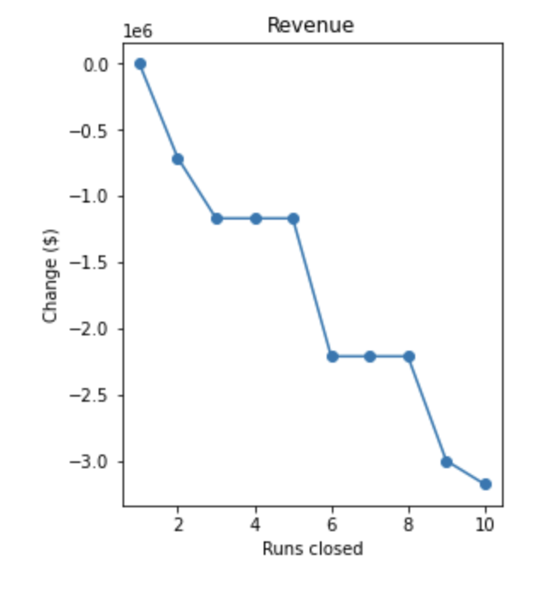
Analysis
Closing runs
To the right is a model of closing up to 10 runs. Closing a few of the runs will help lower ticket price and would also lower operational costs.
Unknown: cost to upkeep the runs
Adding a run, increase vertical drop 150 feet, and installing an additional chair lift.
This increased ticket price by $1.99
Big Mountain is adding a run, increasing the vertical drop by 150 feet, installing an additional chair lift, and adding 2 acres of snow making.
No difference to not adding the 2 acres.
increasing the longest run by .2 miles and guaranteeing its snow coverage by adding 4 acres of snow making capability.
No change to price

Slide 7
Summary & conclusions
I recommend closing a few of the lesser used runs to lessen operational costs while marginally affecting the ticket price.
Competition in
Montana is already at a much lower price point so working to minimize costs where possible without drastically changing the cost of the ticket would be best.

